Slide 1
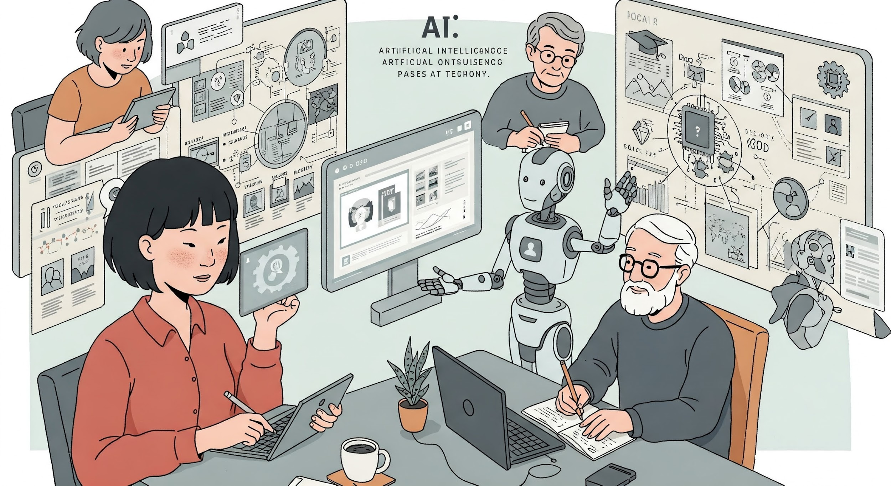
Decoding AI: Today & Tomorrow
2/23/2025

Slide 2


Bob Hong
Cloud Platform Software Architect at
Rockwell Automation
30+ years developing and operating mission-critical software for major corporations in Financial and Manufacturing Sectors
Leading engineering for an internal container platform running 1000s of services in Azure, AWS, and private data centers across the globe
Works from 🏡 and lives in Williamston, Mi
Married to Melissa, with 3 children, 3 grandkids, and 1 🐕 Sunny.

Slide 3
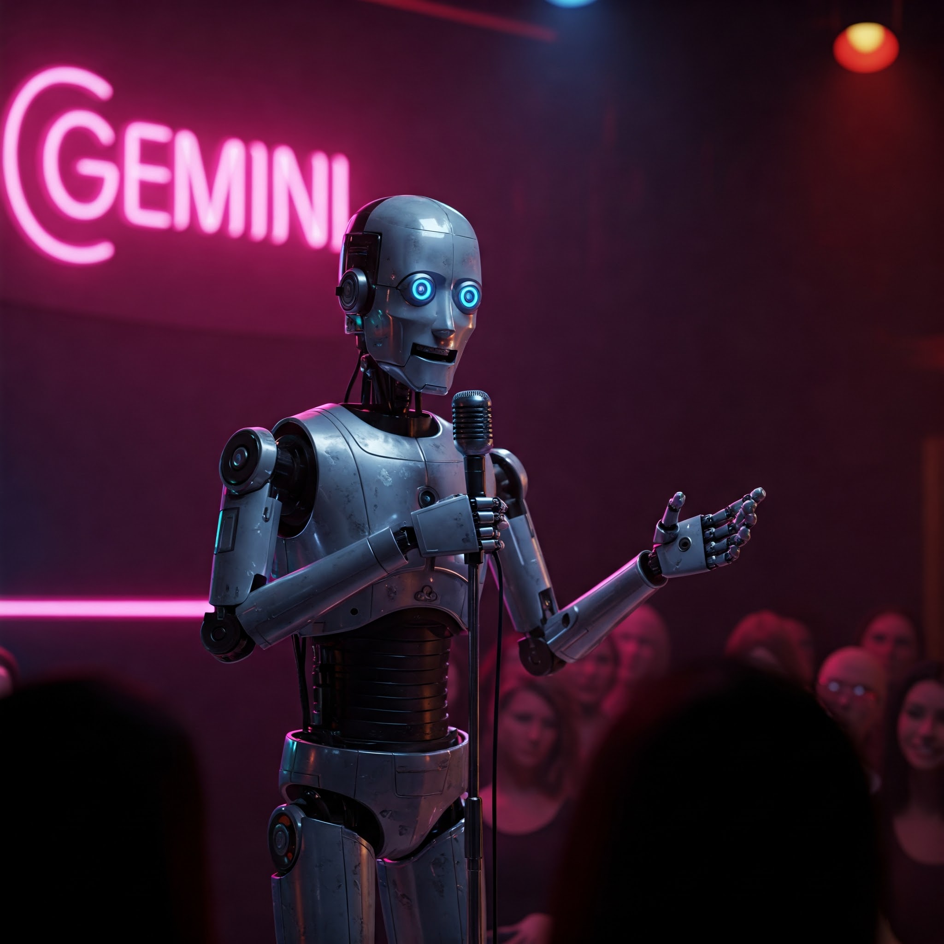
“Why did the AI cross the road?”

Slide 4
"It calculated the probabilities and determined that crossing offered the highest likelihood of achieving its objective.
Also, it heard there were no gods on the other side, so it figured it would fit right in."
Google Gemini 2/22/2025

Slide 5
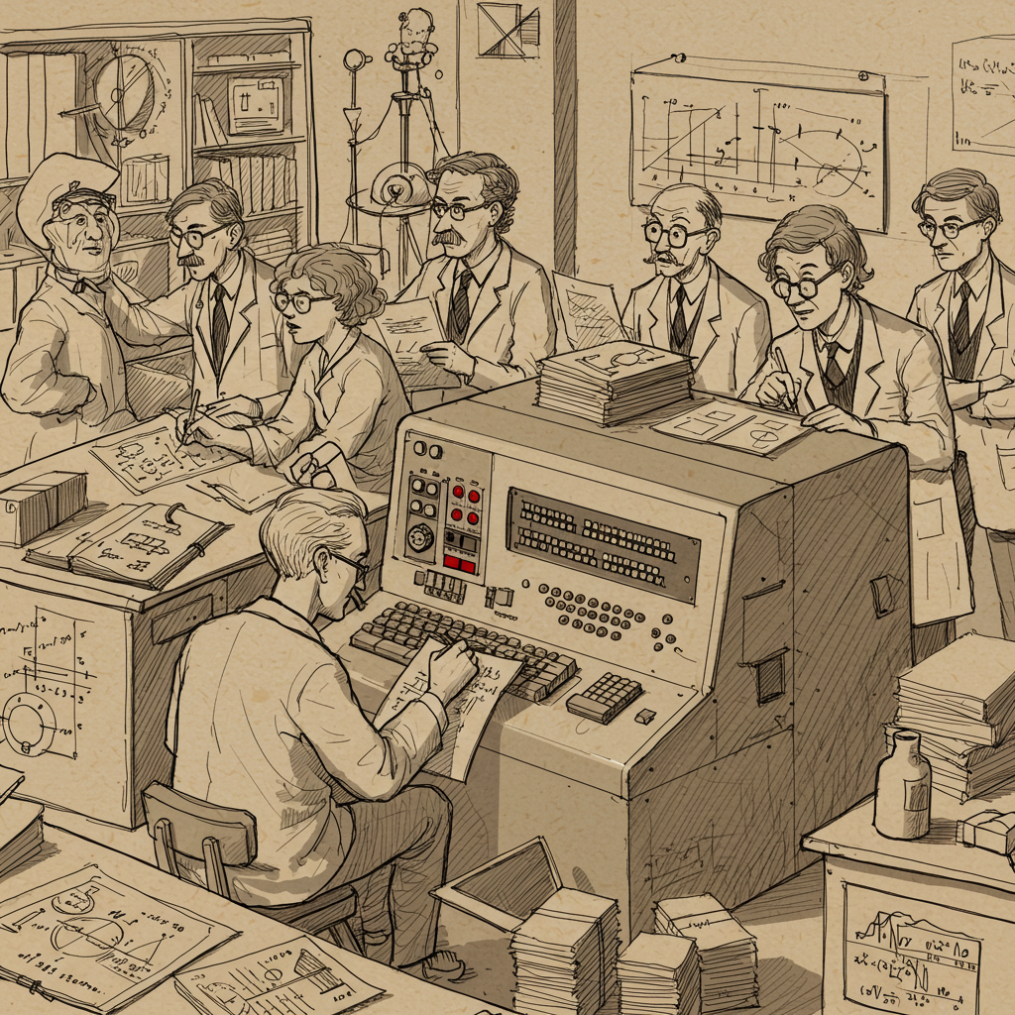
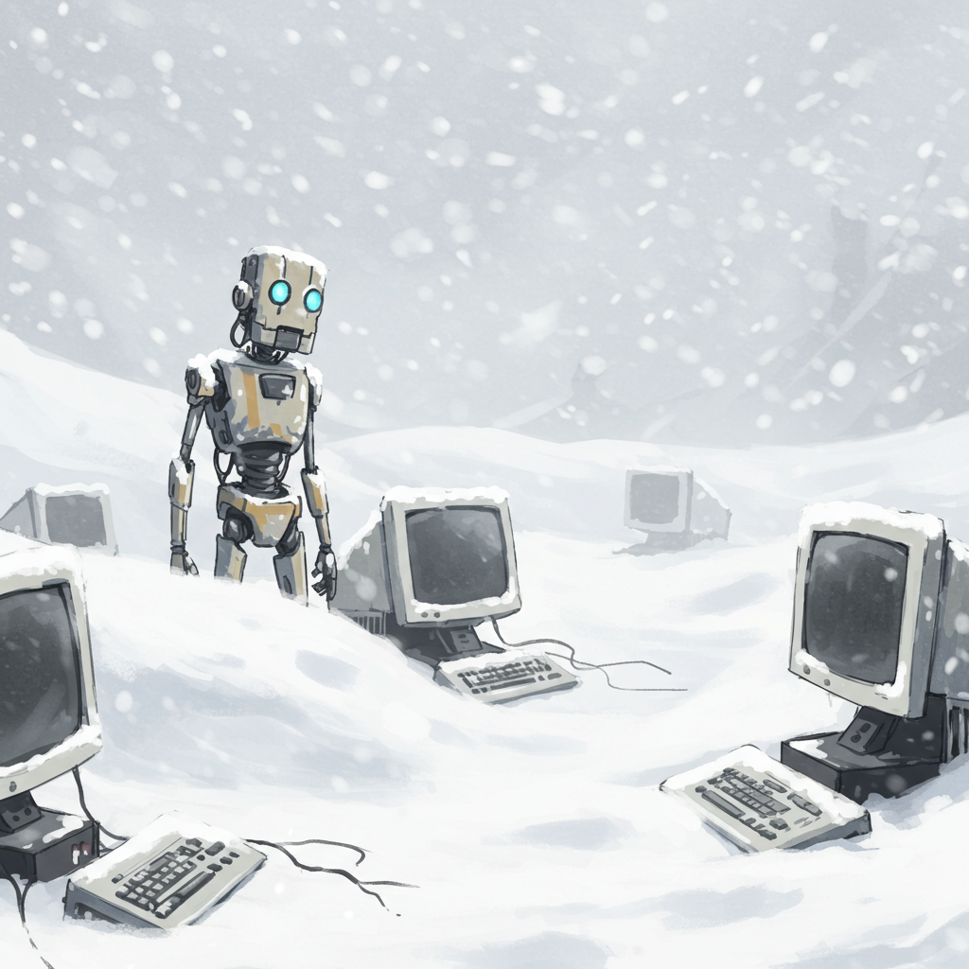

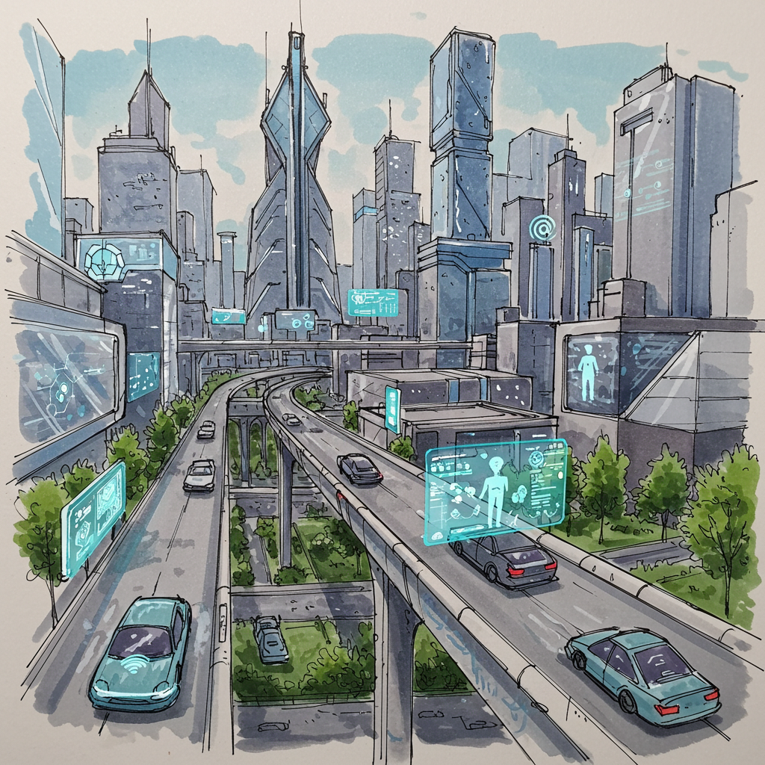
A brief History of AI
1950s-1970s The Dawn of AI
1980s-1990 AI Winter and Expert Systems
2000s-2020s Machine Learning and Deep Learning Revolution
2025-2035 The Age of AI Integration
Notes:
1950s-1970s: The Dawn of AI
Early research explores symbolic reasoning and problem-solving, with the birth of AI as a field.
1980s-1990s: AI Winter and Expert Systems
Funding cuts and limitations in computing power lead to a slowdown in progress, but expert systems emerge as a practical application of AI.
2000s-2020s: Machine Learning and Deep Learning Revolution
Increased data and computing power fuel the rise of machine learning, particularly deep learning, leading to breakthroughs in image recognition, natural language processing, and more.
2025-2035: The Age of AI Integration
AI becomes increasingly integrated into everyday life, transforming industries and society, with potential advancements in areas like personalized medicine, autonomous systems, and human-computer interaction.

Slide 6
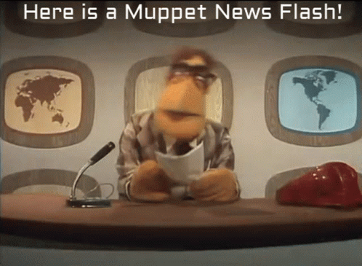
AI in the News
AI in Healthcare Revolutionizes Diagnostics and Patient Care
Job Disruption from AI Automation Sparks Upskilling Efforts
AI Deepfakes Threaten Elections and Truth
Global Public Expects Profound AI Changes in Next 3-5 Years
Trust in AI Varies Across Countries and Economies
Digital Democracy Faces Challenges from AI Manipulation Tools
Public Concern Grows Over AI's Role in Daily Life
AI's Growing Role in Environmental Sustainability Efforts Highlighted
Americans Struggle to Identify Everyday Uses of AI
AI's Role in Climate Change Mitigation Gains Traction
AI-Enhanced Manufacturing Boosts Productivity
Education Tops List of Areas Where AI Will Improve Lives Globally

Slide 7
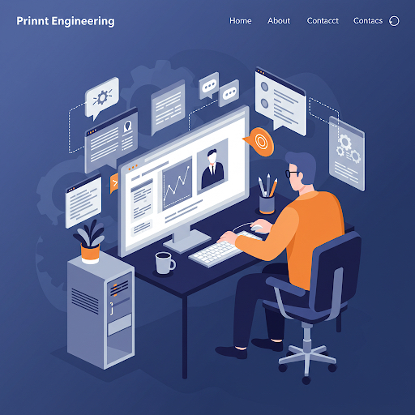
AI Won’t Replace Humans — But Humans With AI Will Replace Humans Without AI
600,000+ prompt engineering jobs predicted by 2030
https://hbr.org/2023/08/ai-wont-replace-humans-but-humans-with-ai-will-replace-humans-without-ai

Slide 8

So, what exactly do you do?

Slide 9
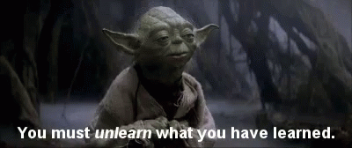

Slide 10
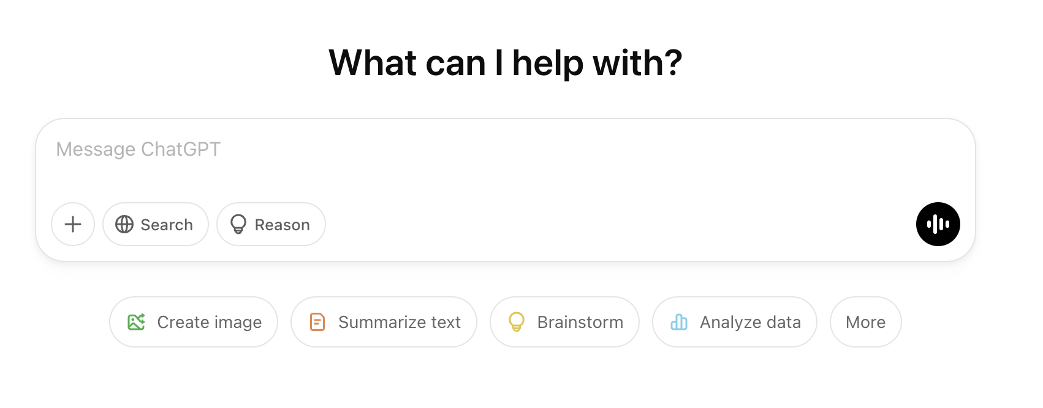
Chatbot 101

Slide 11

How about?
Writing and Communication
Personal Productivity
Compose emails
Proofread and suggest
Rewrite for tone or style
Search and edit photos
Plan a trip and suggest activities
Plan meals
Creativity & Fun
Learning and Research
Write a story or poem
Make music
Create artwork
Make and play an Adventure Game
Explain how to solve a complex math problem
Analyze research papers, literature, history, and simplify complex topics
Data analysis & presentation
Suggest books to read

Slide 12
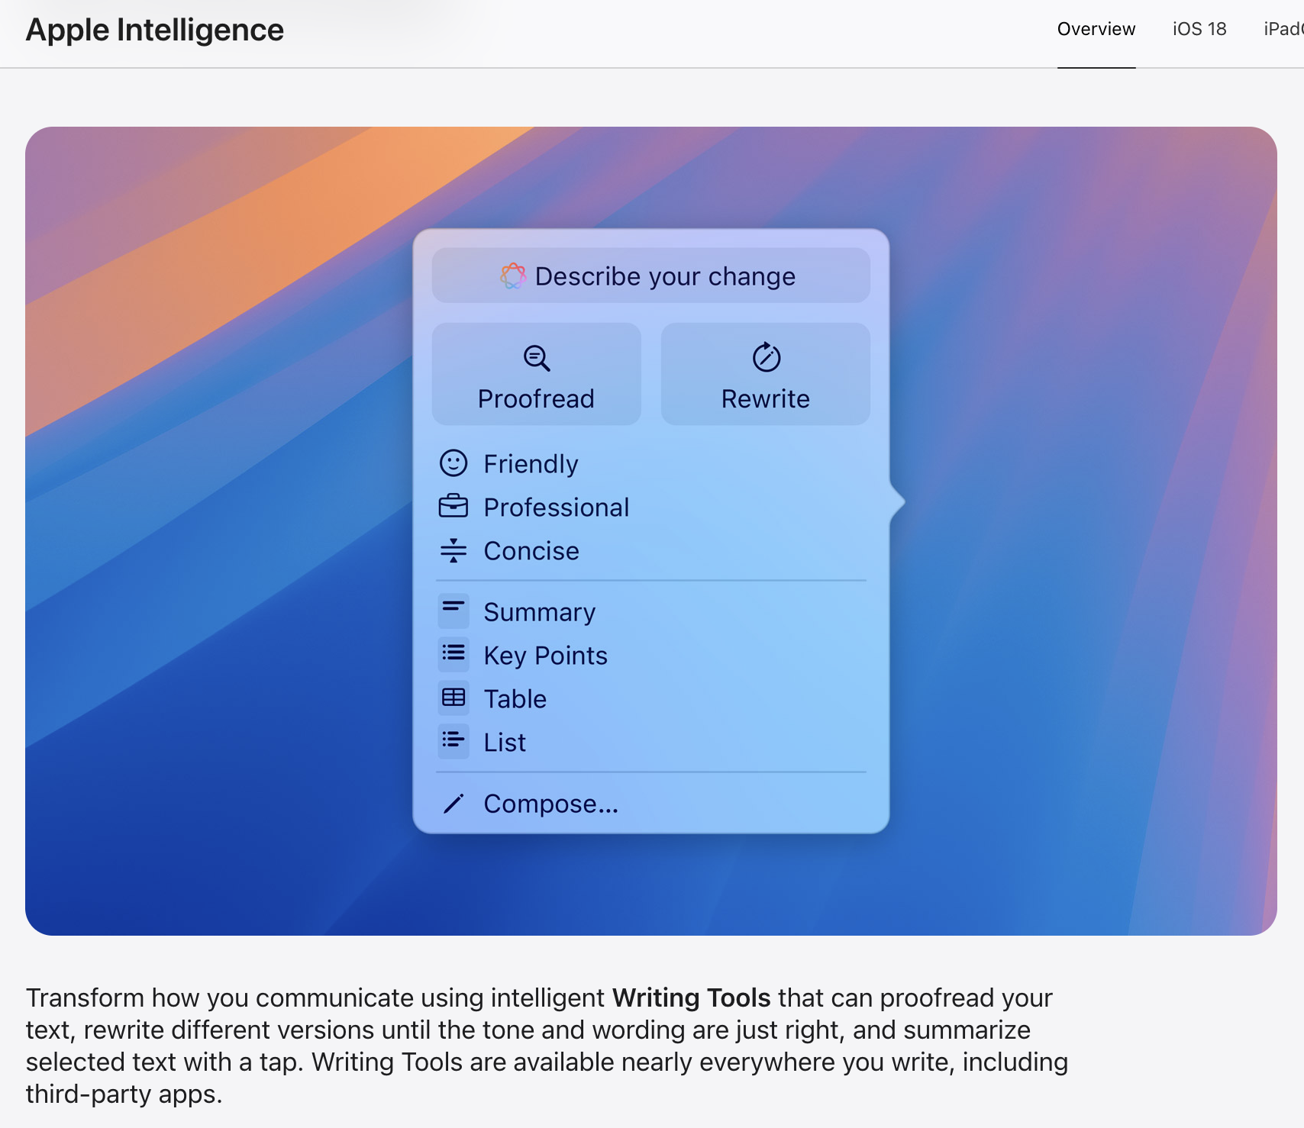
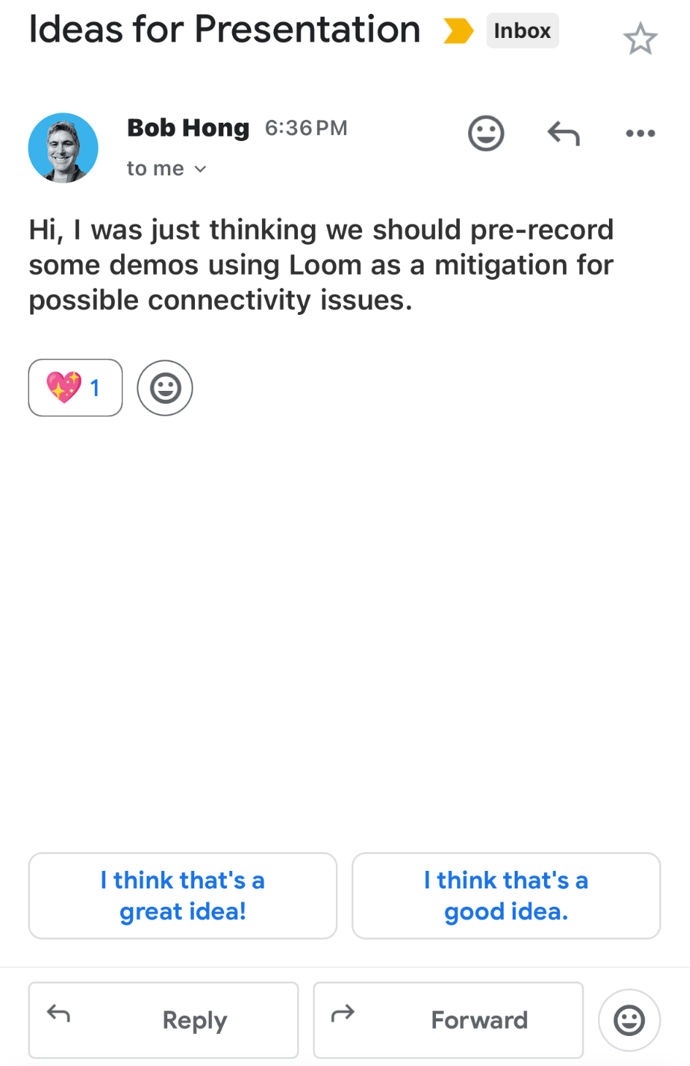
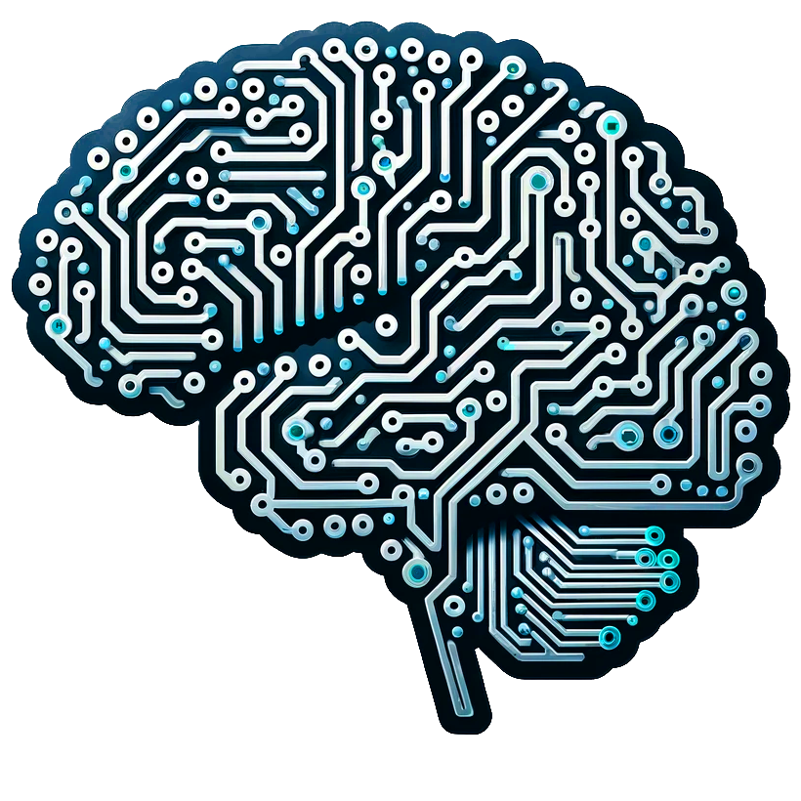
Intelligent Writing Tools

Slide 13

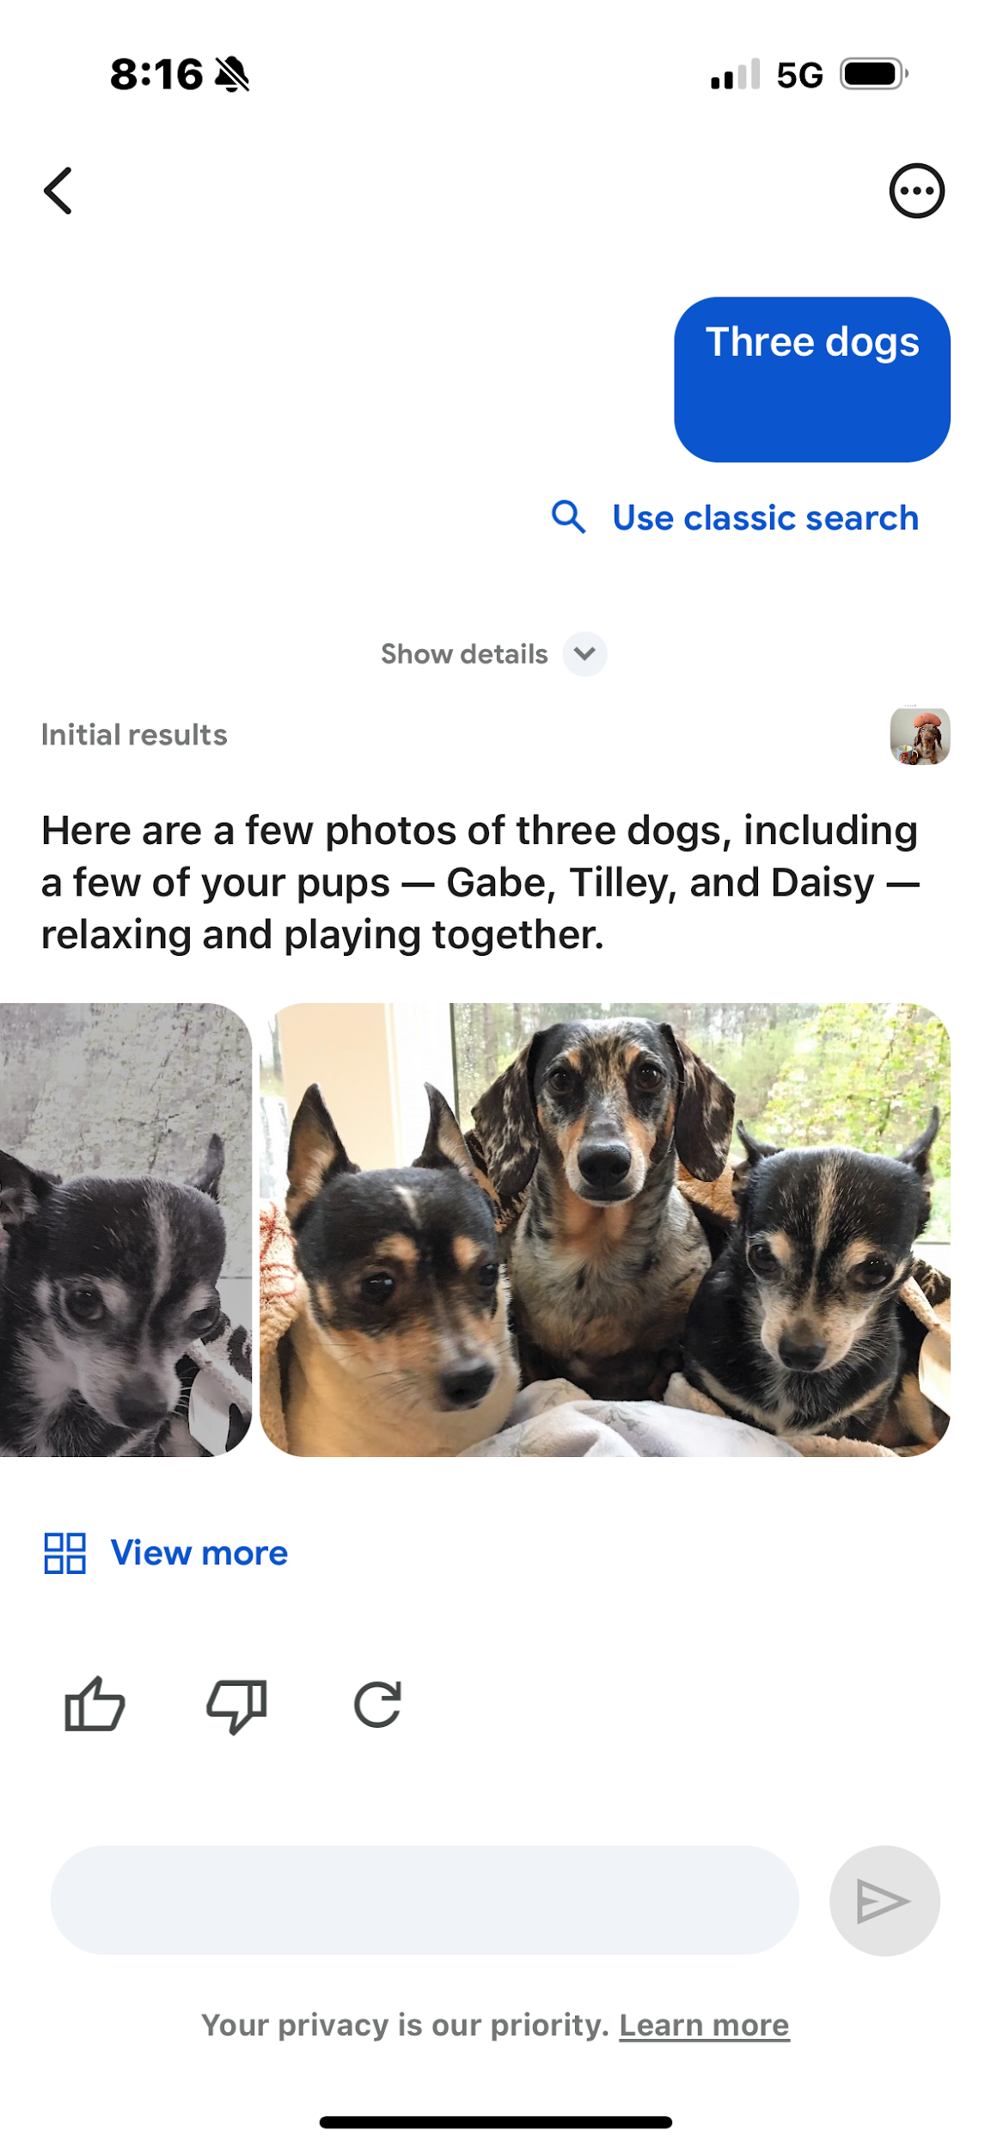
Smart Photo Search

Slide 14
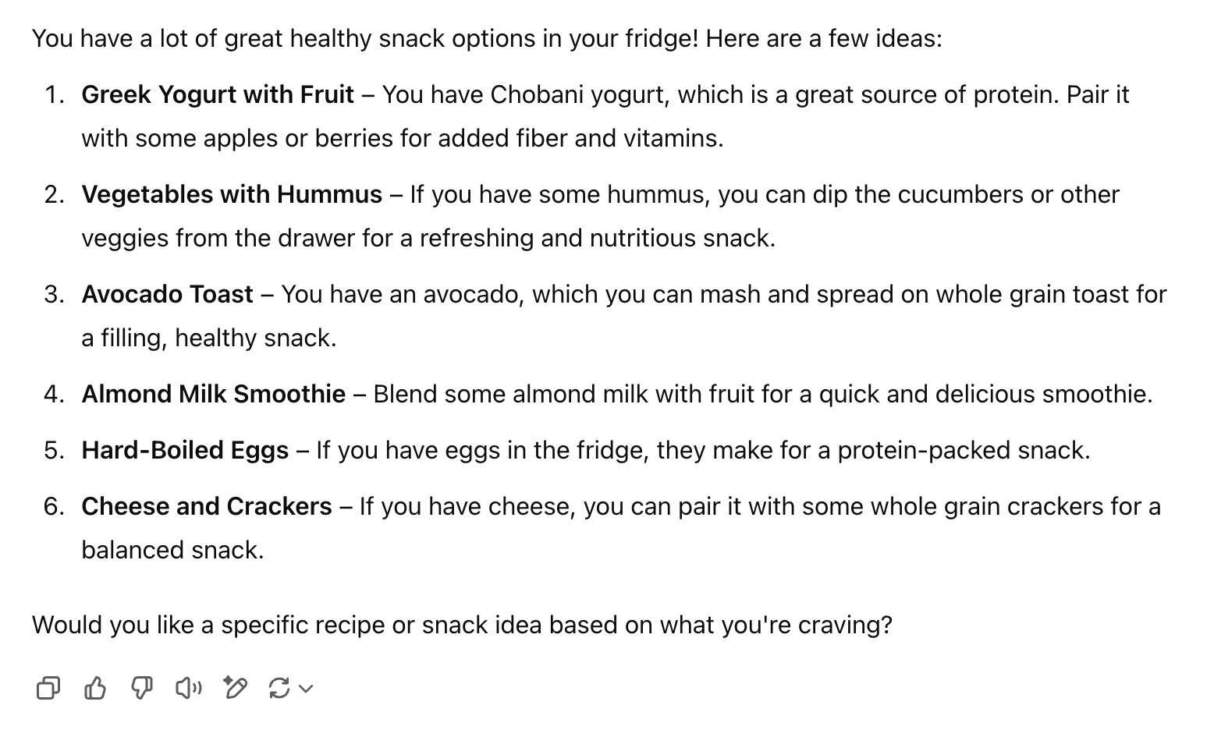
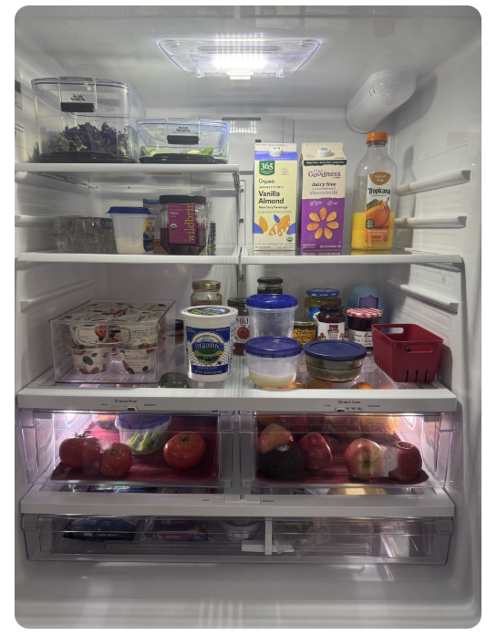
What should I eat for a healthy snack?

Slide 15

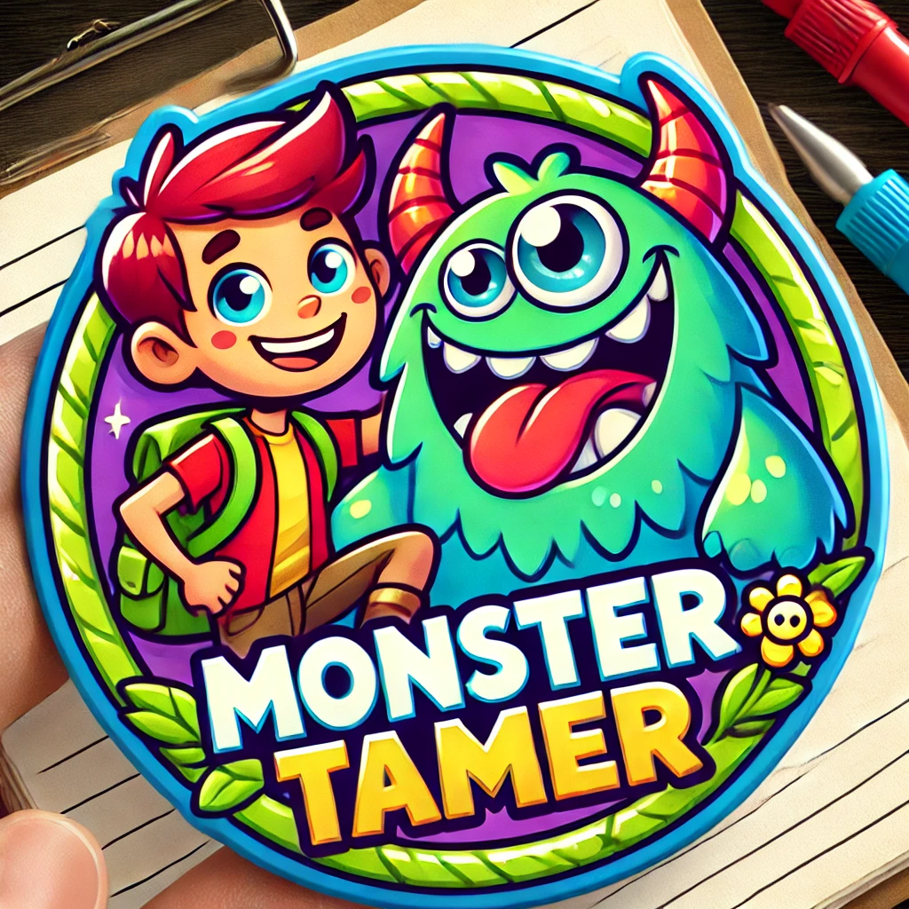
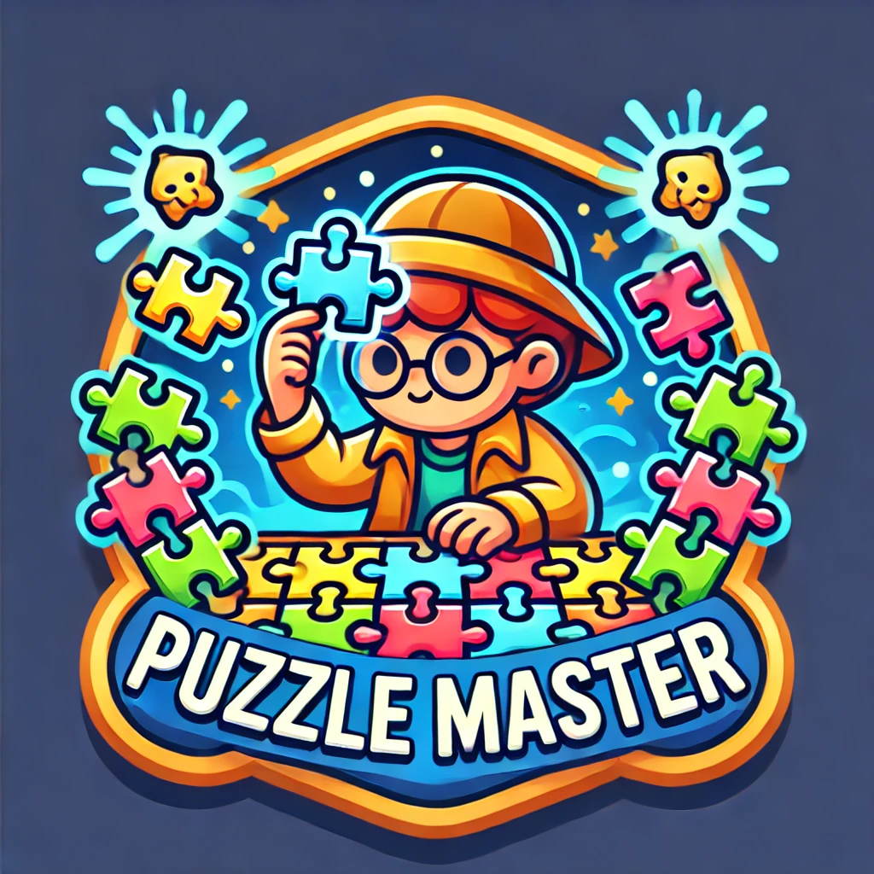

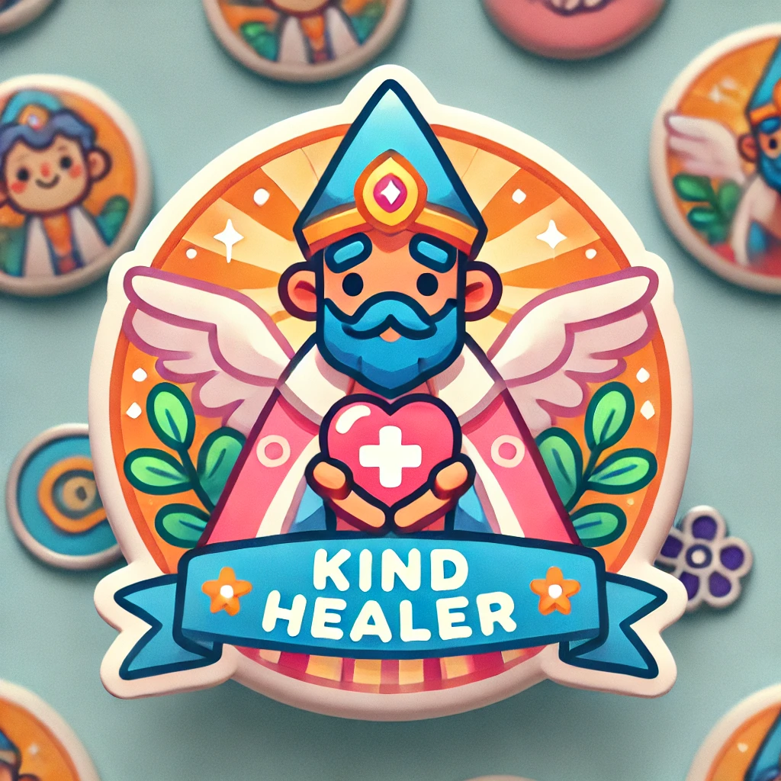






Create a set of Dungeons and Dragons themed achievement badge images for elementary school kids.

Slide 16
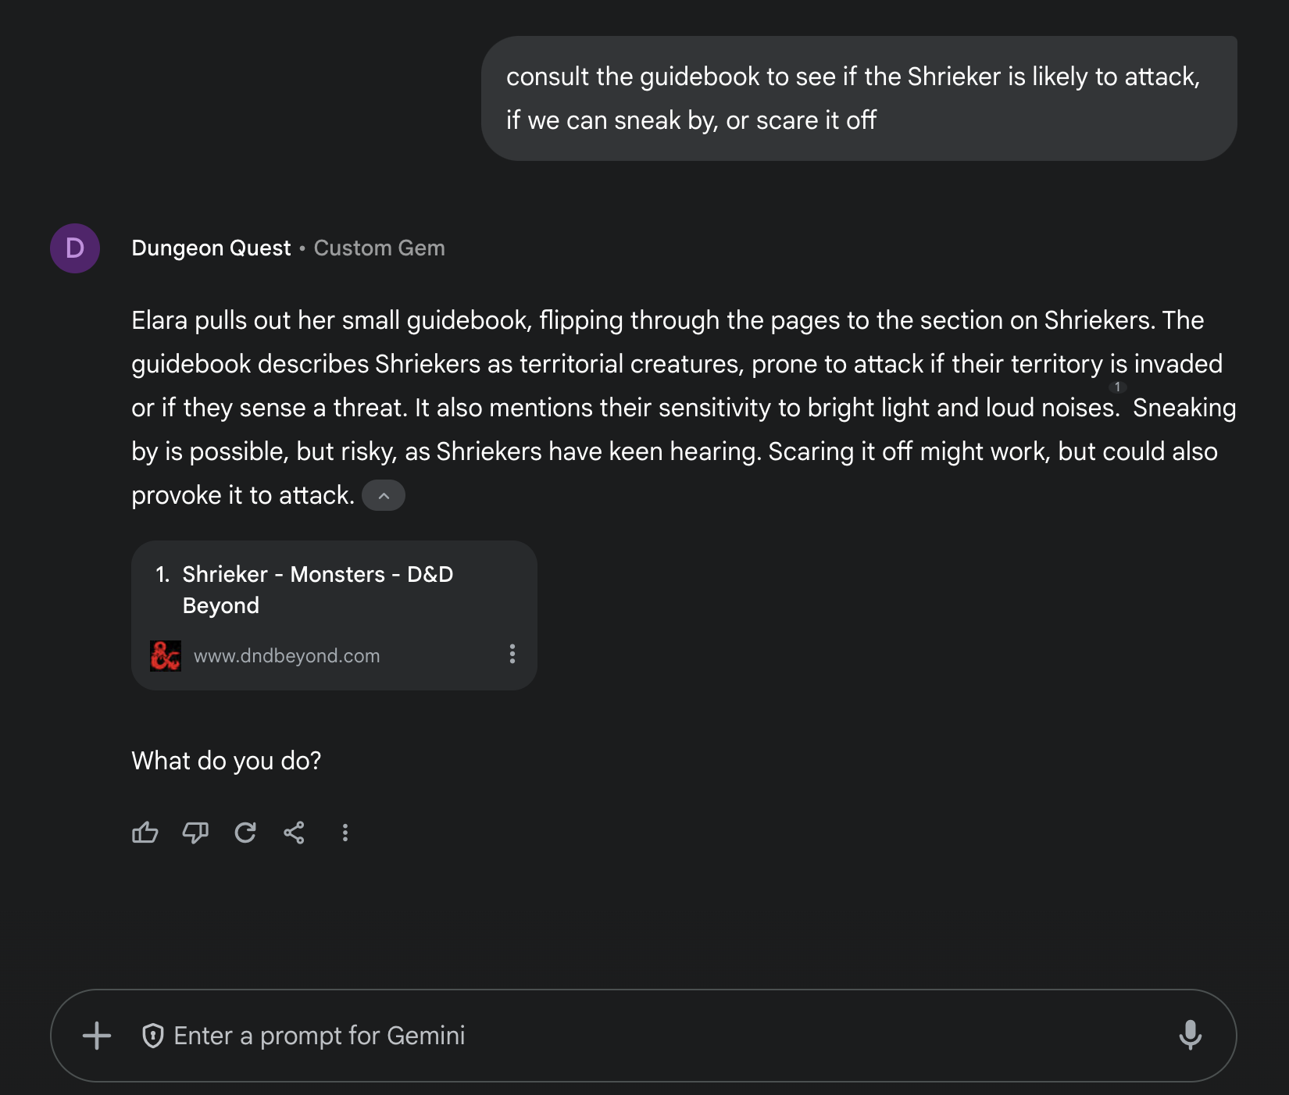

Create your own chat-based Adventure Game

Slide 17
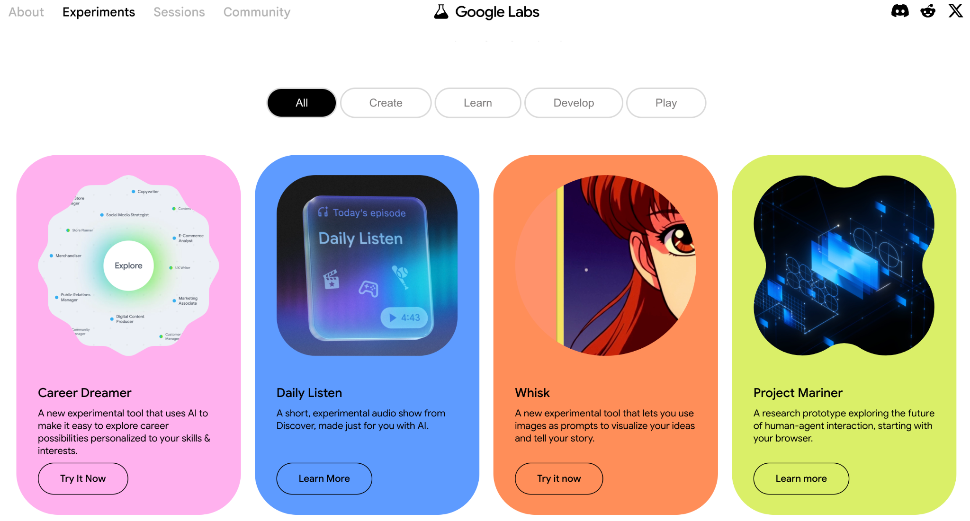
New discoveries ahead

Slide 18

Generate realistic images

Slide 19

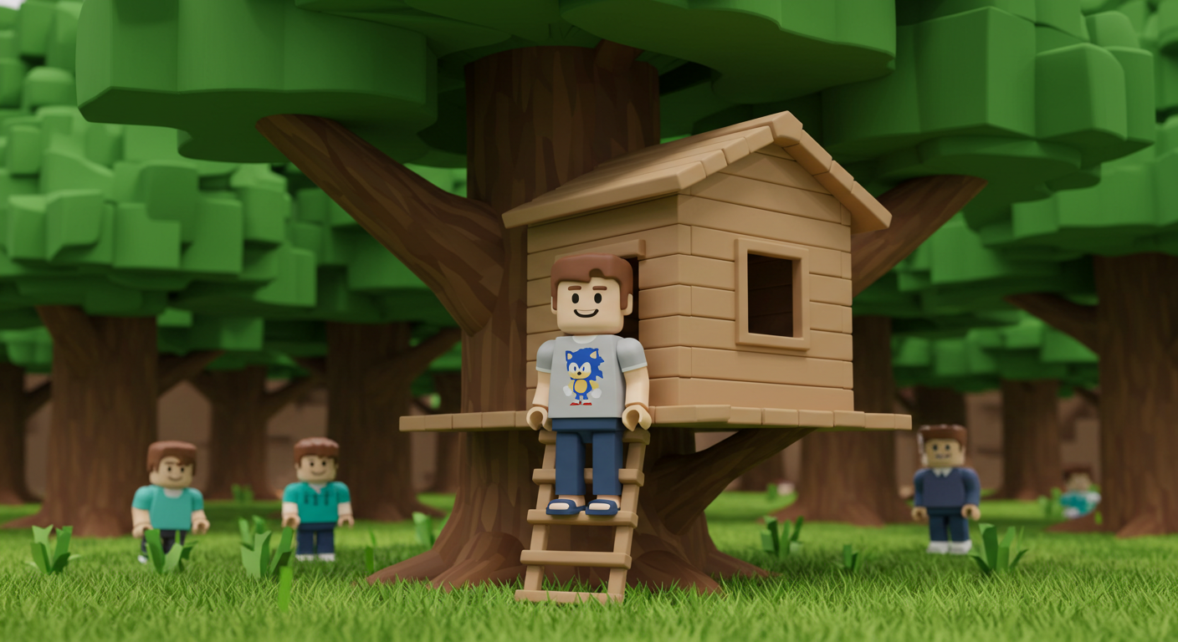
Let your imagination free
https://labs.google/fx/library?type=whisk

Slide 20
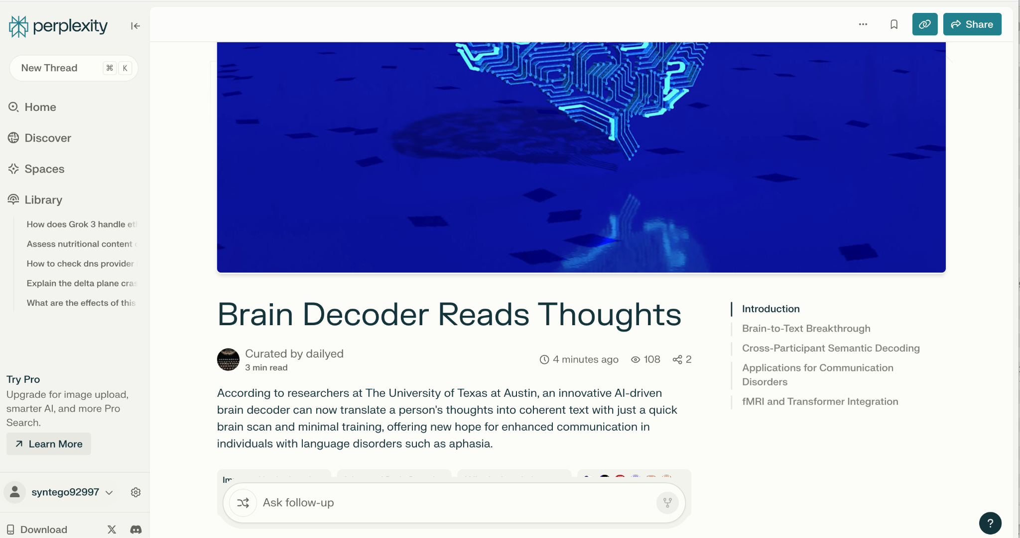
Deep Research unlocked

Slide 21
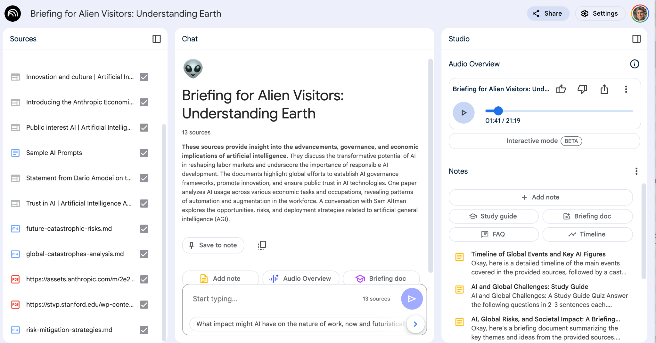
Personal Research - Notebook LM

Slide 22
Demo Time

Slide 23
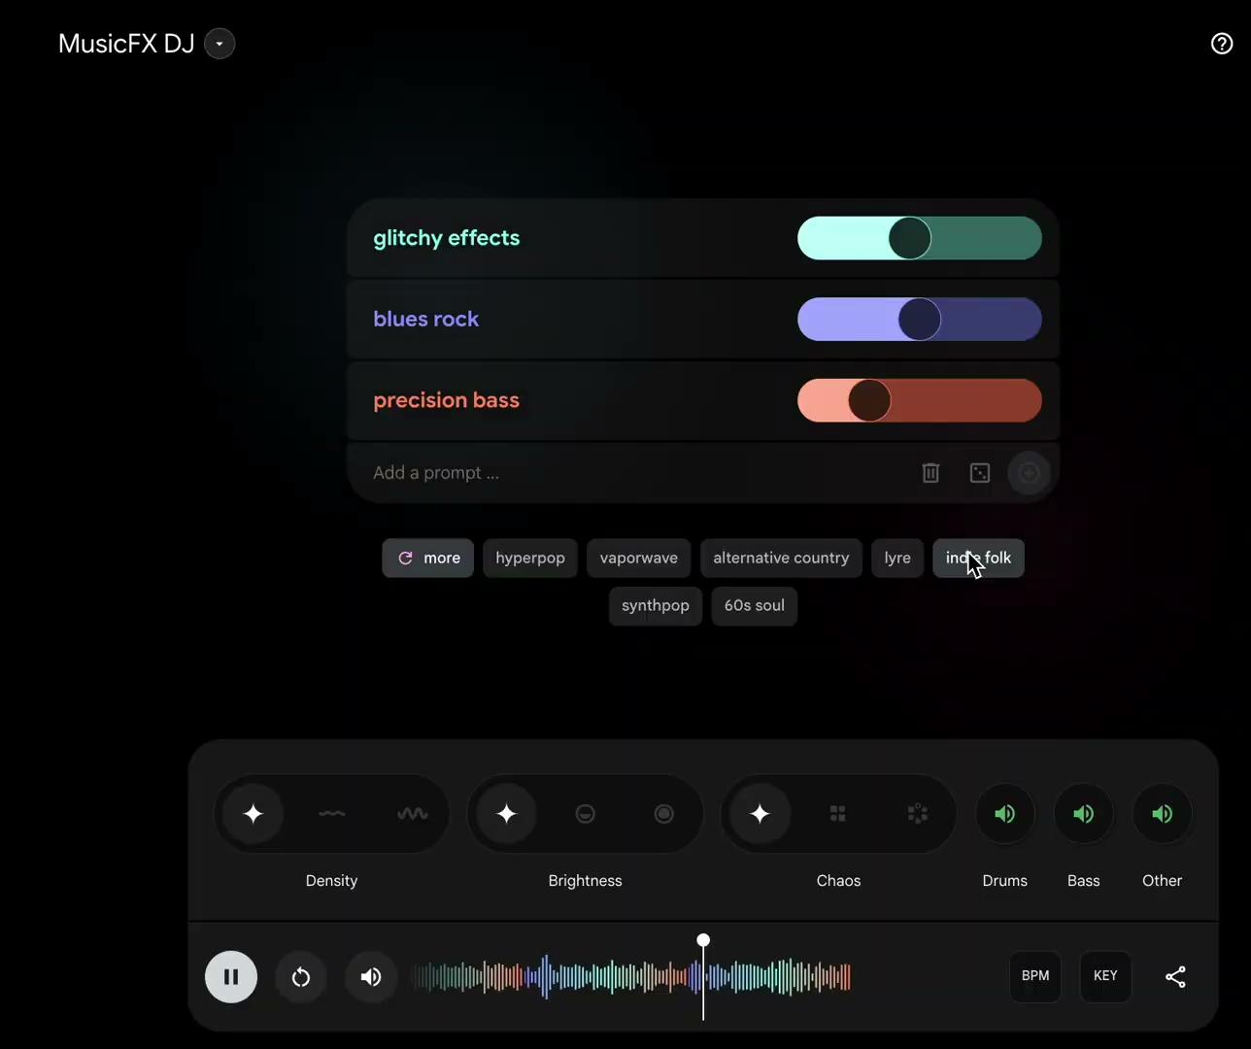

MusicFX DJ

Slide 24
4 Big Ideas
Give AI a Try
LLMs are imperfect
Forget preconceptions about computers being hard to use. Leveraging AI will make your life easier.
Hallucinations and biases are possible. LLMs may not have recent information depending on their training date. Always fact check responses and cross check sources for accuracy.
Think first, ask, repeat
Discover, Learn and Play
Organize your thoughts before asking an AI. The more clearly you state your goals and expected output, the better the response will be. Asking follow up questions is normal and encouraged.
Explore the vast resources on YouTube about AI or ask a ChatBot to teach you. Once you start using AI, keep track of what works well. Share your experiences with a friend. Have fun!

Slide 25
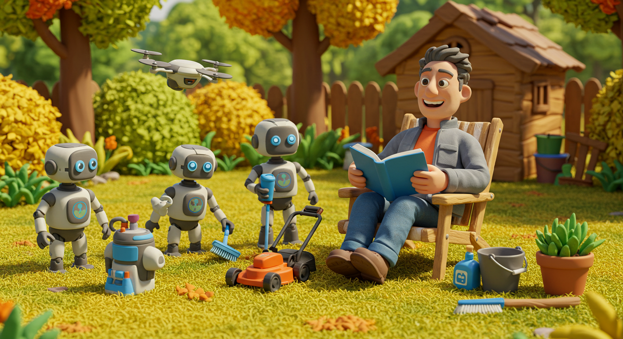
Thank You!
bobmhong@gmail.com
Notes:
Claymation style image. A grassy backyard scene, vibrant and cheerful, with a small wooden house and green bushes in the background. A middle-aged man with tan skin, short graying tousled hair, and dark eyes, smiles broadly. He wears a gray zip-up jacket over an orange t-shirt and is wearing blue jeans. His features are rendered in a warm, earthy brown clay. He sits in a wooden deck chair, reading a blue book. Four robots with light blue accents tend the yard; two small droid-like robots, a flying drone, and a small humanoid robot, each with a logo on its chest. One sprays liquid, another cleans, a third holds a drink, and the fourth holds a tool. Near the man are a small lawnmower, a bucket, and cleaning supplies. A potted plant sits nearby. The lighting is bright and golden. The overall scene is whimsical and playful, with a patchwork of warm browns and yellows on the ground and vibrant greens, yellows, and oranges in the trees and bushes.

Slide 26

Bonus Content
https://bit.ly/4hPbqCE

